Slide 1
Can we predict the severity of the collision ?
Seattle collision data

Slide 2
BACKGROUND
In the modern world road traffic accidents are very common in each and every part of the world. Seattle is one the busiest cities and as of 2017, there have been more than 11,000 motor vehicle-involved collisions per year.
These collisions not only lead to high property damage but may result in injuries and in worst case scenarios even death. In 2017, a total of 187 fatal and serious injury collisions were reported on Seattle streets.
The causes behind the collisions may range from physical factors like road conditions, lighting, weather, time of day etc to human factors like inattention, speeding, under influence.
Various efforts and steps can be taken in order to minimize these collisions. Every city has devised certain traffic rules and regulations to help in this regard.
Even, WHO has given certain recommendation to be followed by the government agencies to have an impact on the rate collisions and more importantly to reduce the cost of property damage as well as of life. Even small regulations sometimes have much greater impact.

Slide 3
PROBLEM
PROBLEM: To predict the severity of collision based on the various physical and human factors. And make recommendations and take necessary actions based on those predictions like improving the road conditions, lighting, regulations on speed in various area etc.
STAKEHOLDERS:
General Public- vehicle drivers and pedestrians to take necessary precautions in certain circumstances.
Seattle Traffic department- to prepare plans regarding improving road conditions, lightning, speeding limits, etc
Car manufacturing industry- To increase car re-enforcements at the different sites of cars which are frequently involved and especially responsible for the most serious injuries and fatalities.
Weather department- to make necessary updates and caution messages for different locations depending upon weather.
Health and paramedical departments- to take necessary steps to provide faster emergencies services in the areas more prone to accidents to reduce the loss of life.

Slide 4
DATA
DATA.
Data utilized for this analysis was downloaded from Kaggle Seattle collision dataset as csv file.
http://data-seattlecitygis.opendata.arcgis.com/datasets/5b5c745e0f1f48e7a53acec63a0022ab_0.csv

Slide 5
DATA UNDERSTANDING AND CLEANING
PARAMETERS NOT USEFUL. After exploring the data, we found it to have 40 parameters, among those some were found to be least relevant.Since SEVERITY DESC AND SEVERITYCODE have the same information. SEVERITYCODE was dropped. Also, the unknown values of SEVERITYDESC were replaced by NAN and dropped. SEVERITYDESC values were also put into two categories PROPERTY DAMAGE ONLY=1 INJURIES, SERIOUS INJURIES AND FATALITIES=2
DEALING WITH MISSING DATA
We found that in our data there were lot of parameters with very high number of missing values. Dropping all those values would result in loss of lot of information but including all of them would result in increased noise and give biased analysis. So, we decided to make two different datasets
1. DATA INCLUDING UNKNOWN, OTHERS, NOT MENTIONED VALUES
We tried to include as much data as possible for the analysis.
2. DATA WHERE ALL NAN, UNKNOWN, OTHER AND NOT MENTIONED VALUES WERE REMOVED
DATA INCLUDING UNKNOWN, OTHERS, NOT MENTIONED VALUES

Slide 6
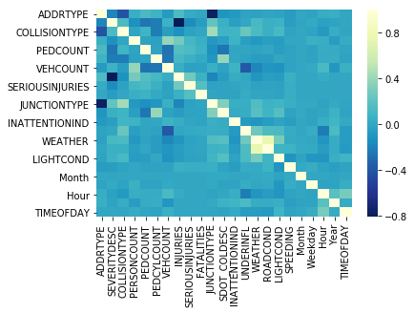
HEATMAP

Slide 7
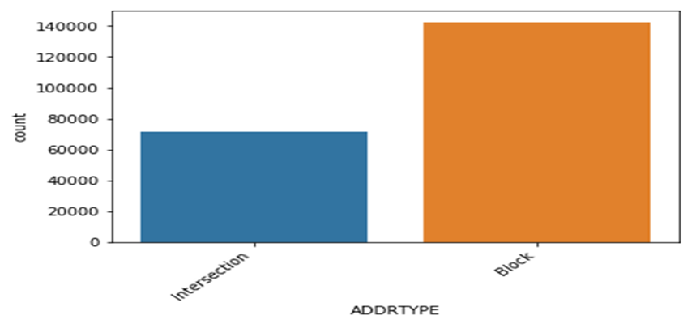
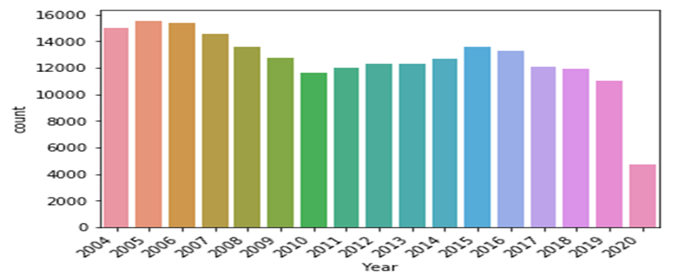
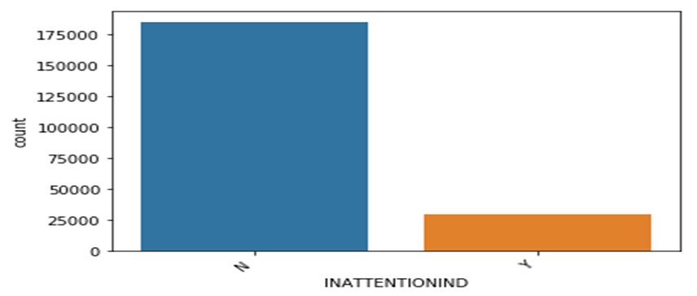
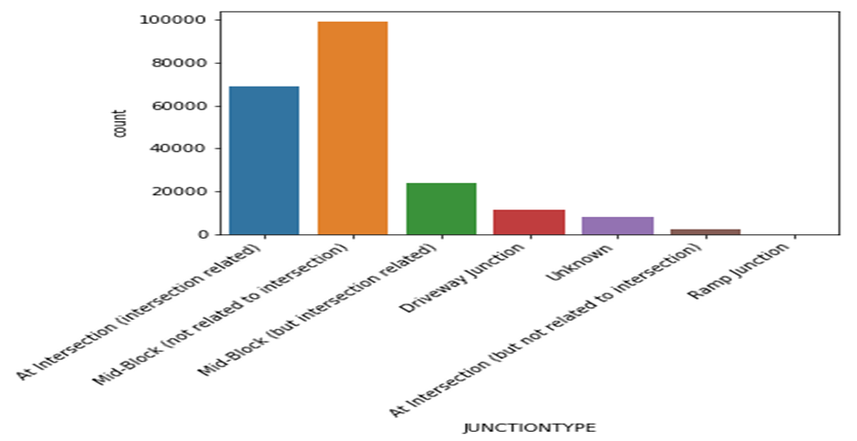
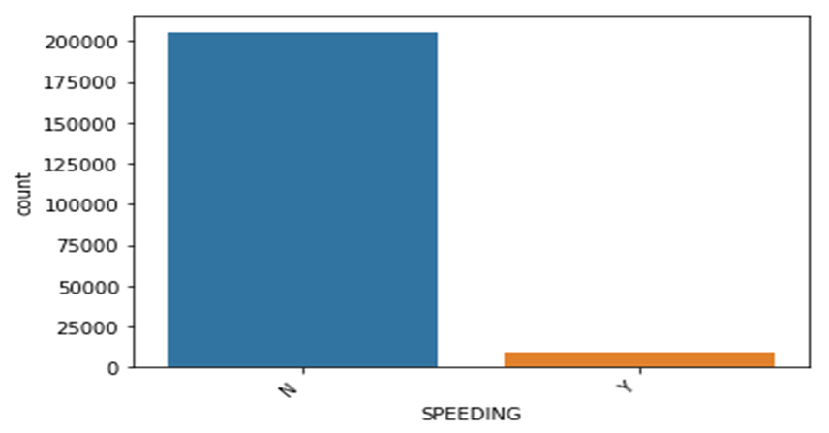

Slide 8
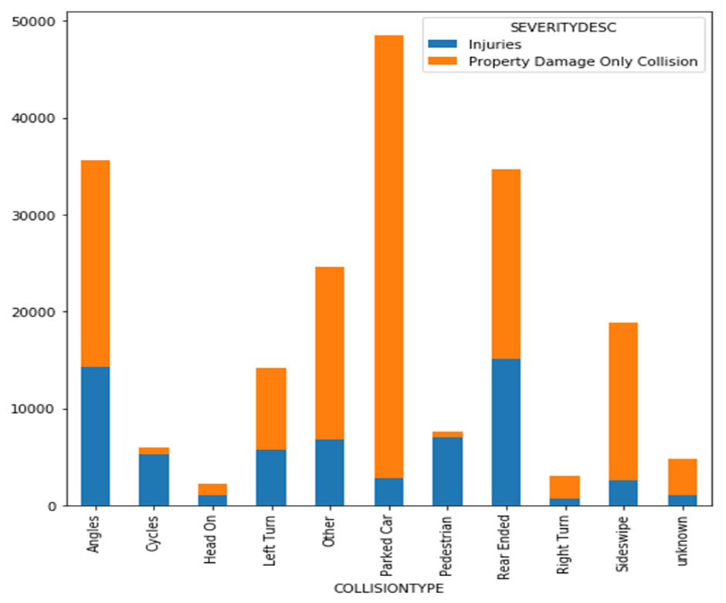
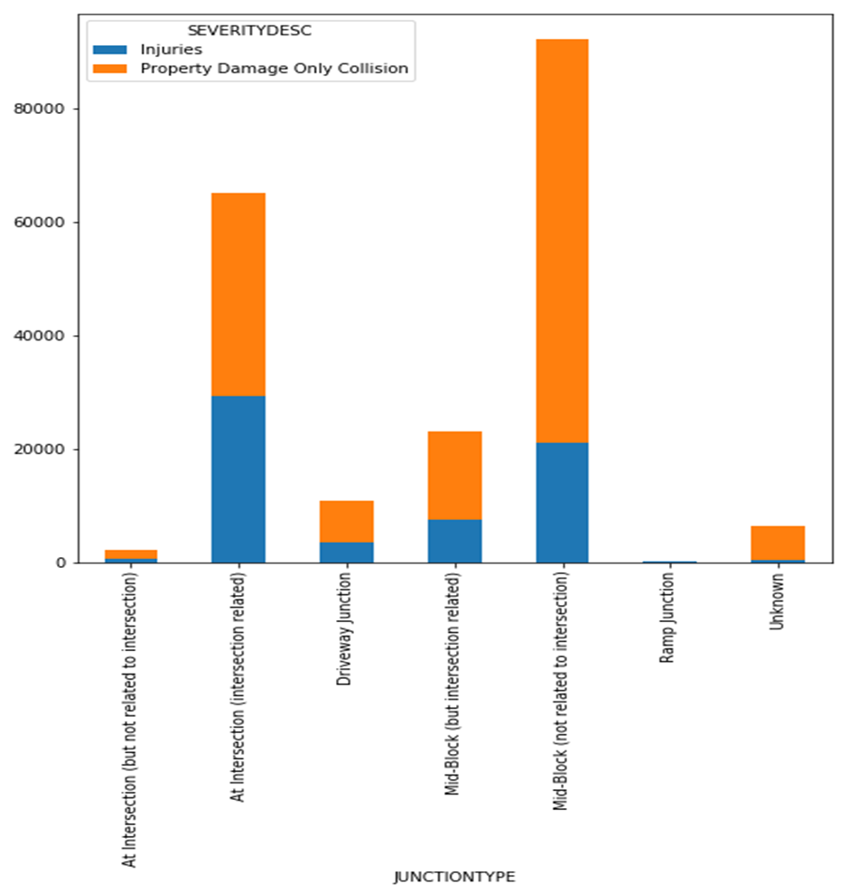
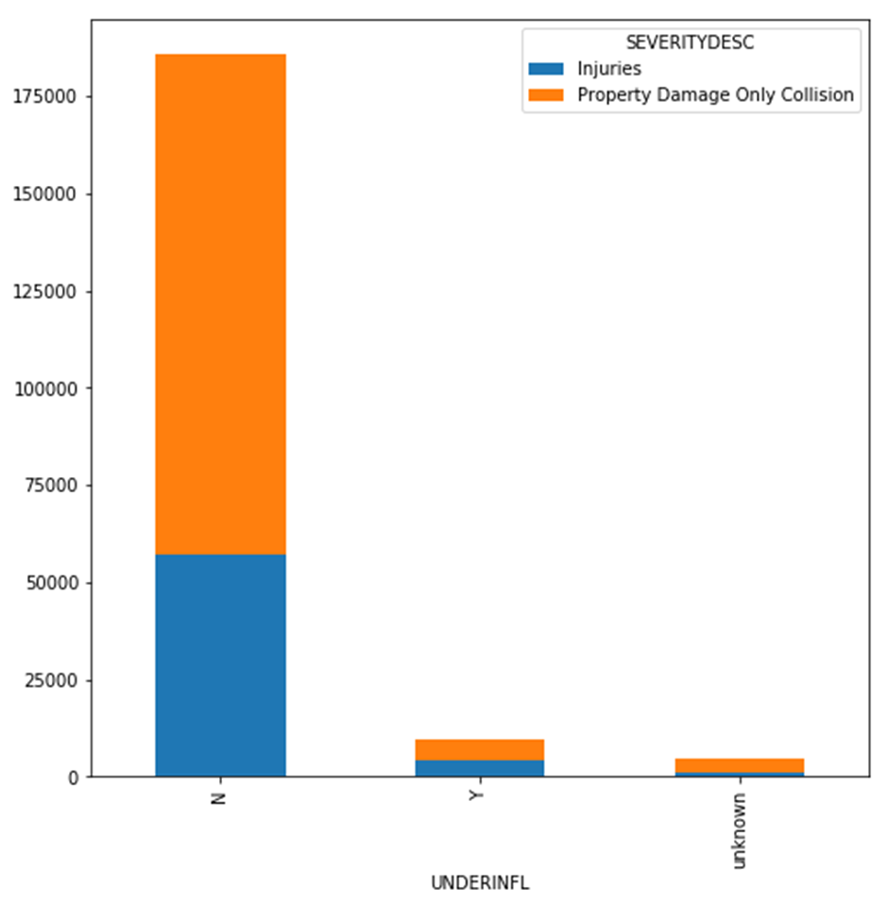
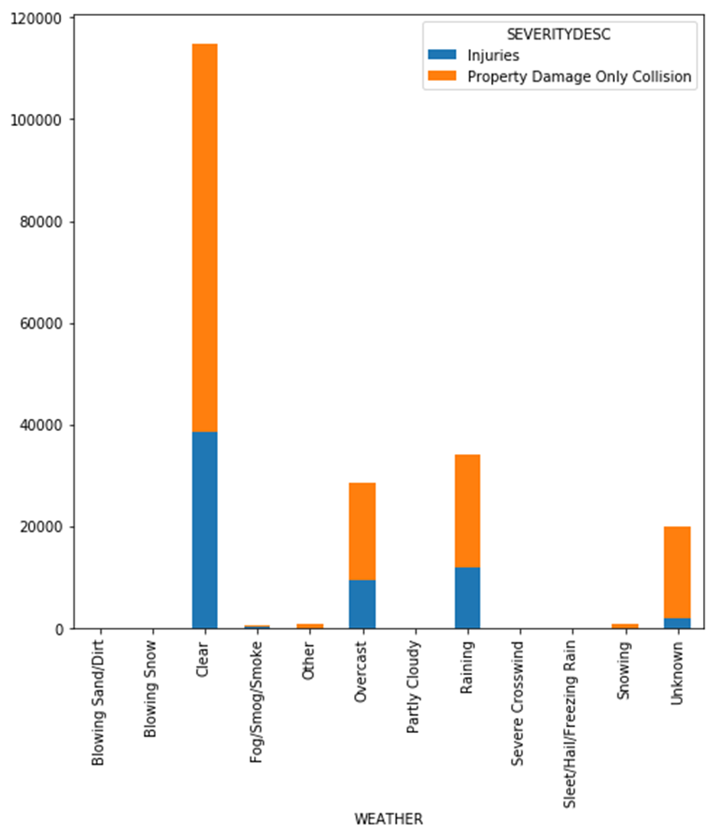
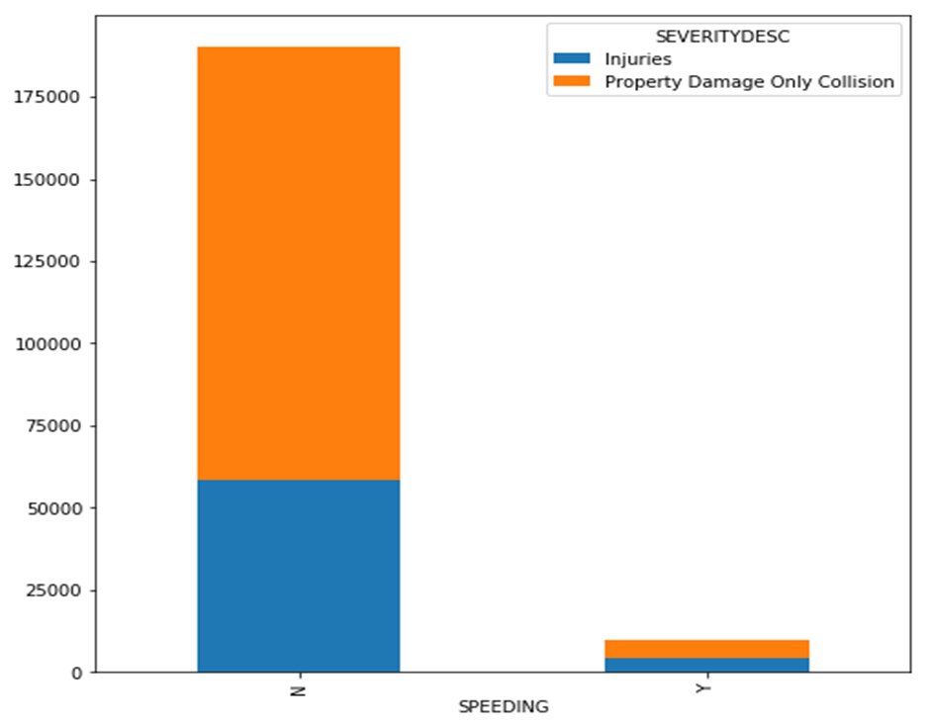

Slide 9
MODEL DEVELOPMENT
MODEL DEVELOPMENT: We first developed the machine learning classification models with as much data as possible to include. We found the model showing the best accuracy metric was Decission Tree Model with jaccard score of 0.71 in this specific data(after balancing the data).
We also used the Random Tree Classifier on the imbalanced dataset of the same data and found the accuracy score of 0.75.
In our second dataset, in which all of the missing, unknown, not mentioned values were dropped we found that SVM model with rbf and Random forest model showed highest jaccard score of 0.73
We concluded that for the best model was for data including all Nan, UNKNOWN values and imbalanced data with Random Forest classifier (0.75) and had the best predictive outcome.
Random Forest classifier was also used to find features most contributing to the information gain.

Slide 10
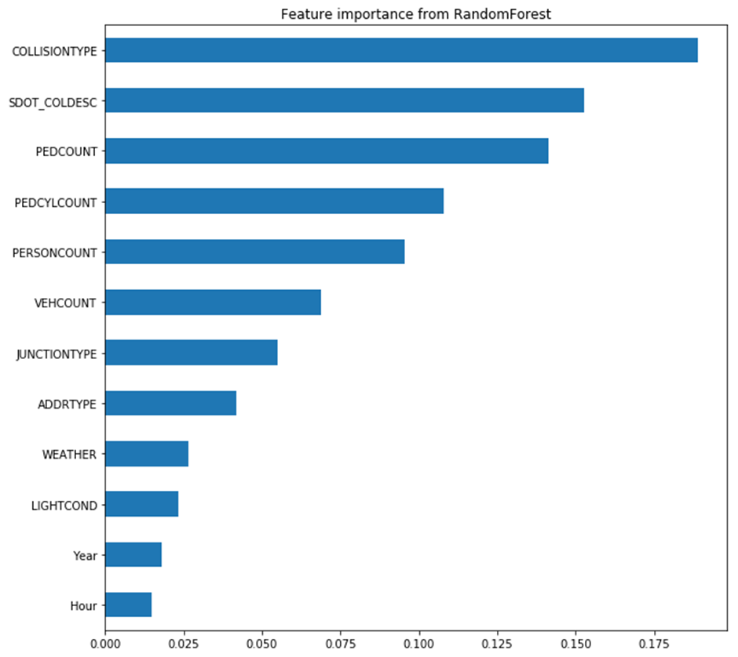
Feature importance from RandomForest Classifier Showed the collision type, SDOT COLDesc followed by pedcount, pedcylcount,personcount and vehcount were the most important features affecting the outcome.

Slide 11
RECOMMENDATION
The locations with maximum number of collisions may require more emergency services and hospitals in the area, so that the serious injuries and fatalities are kept to minimum.
As the number of collisions in the year 2020 shows lowest number so far, one because the year is the not over yet and more importantly can be related to corona virus pandemic which may have led to decrease in traffic. So we may indirectly infer that traffic may have been one of the contributing factors for collisions. Hence steps to decrease the traffic at any moment of time and better traffic control may also affect the rate of collisions.
Speeding and under influence was found as a reason only in small number of collisions but in both cases nearly 50% led to injuries. Thus more speeding limits especially at the locations with maximum collisions over the years and more strict regulations for driving underinfluence.
We also found the collisions resulting in injuries were found little more in collision at the intersection which may call for different measures at the intersection like speed limits and measures that may provide better visualisation of the other side at the intersection.
Head On collisions, angles and rear end collisions resulted in more injuries than any other type of collision. So more reinforcement from the automobile industry at those places in the vehicle may lead to less injuries in a collision.
By using our predictive model we may be able to predict the outcome based on the variable input upto 75% accuracy. We were not able to improve the accuracy by including all the data as possib

Slide 12
CONCLUSION
Seattle collision data provides lot of information which we utilized into the prediction model but we strongly believe that there are many other parameters which were not included in data and may have more impact on the type of collision than the others .
We may need to include those parameters in future data collection e.g condition of the vehicle, talking on the phone, pedestrian not crossing at zebra crossing etc. These parameters may further improve accuracy of the model.

